Slide 1
Emotion Recognition & Generative AI An End‑to‑End ANN Platform
29 Sep 2025

Slide 2
Overview
• Dataset & Augmentation • Model Design & Training • Synthetic Generation & GenAI • Explainability & XAI • Mobile App Implementation • LLMs & Transformer Theory • Pros, Cons & Opportunities • Conclusion & Future Work
[1]

Slide 3
Dataset & Augmentation
Class | Count | Percent
angry | 5 089 | 11.63%
fearful | 4 589 | 10.49%
happy | 13 370 | 30.56%
neutral | 8 268 | 18.90%
sad | 7 504 | 17.15%
surprised | 4 936 | 11.28%
[2]

Slide 4
Model Design & Training
Pretrained ResNet50 backbone with custom head
Two‑stage fine‑tuning: head warm‑up → full unfreeze
Discriminative LRs, mixed precision & gradient clipping
Regularisation: label smoothing, MixUp, class weights
Hyperparams: img_size=224, batch_size=32, epochs=80
[3] [4] [5]

Slide 5
Synthetic Generation & GenAI
Stable Diffusion (v1.5) for class expansion
Prompt templating to control expressions
Quality filters: single face detection, blur variance
Perceptual hash deduplication & fraction capping
Added 2 634 synthetic images → total 83 004
[6]

Slide 6
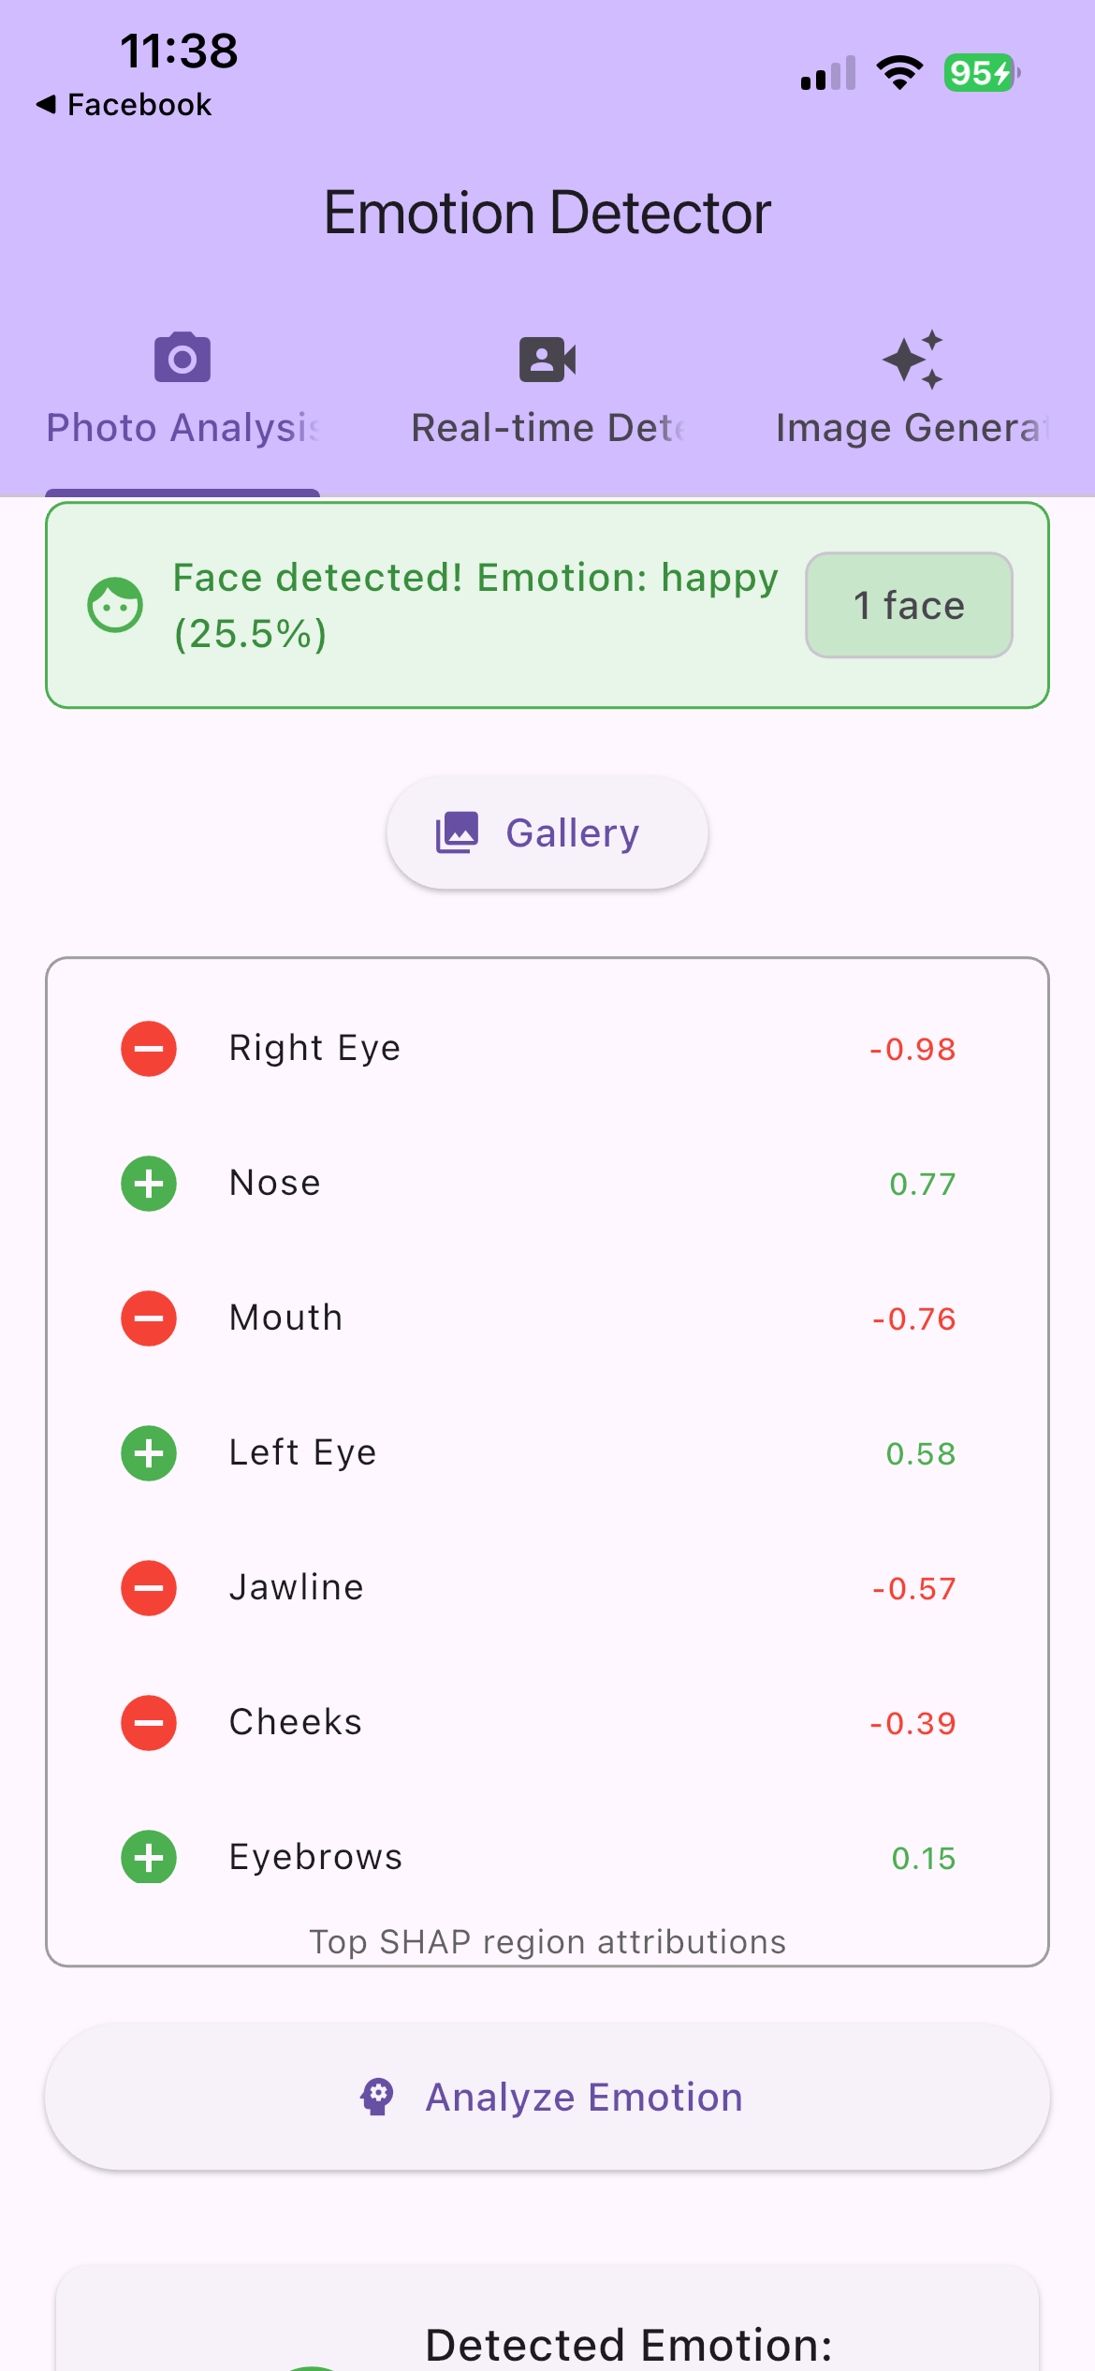
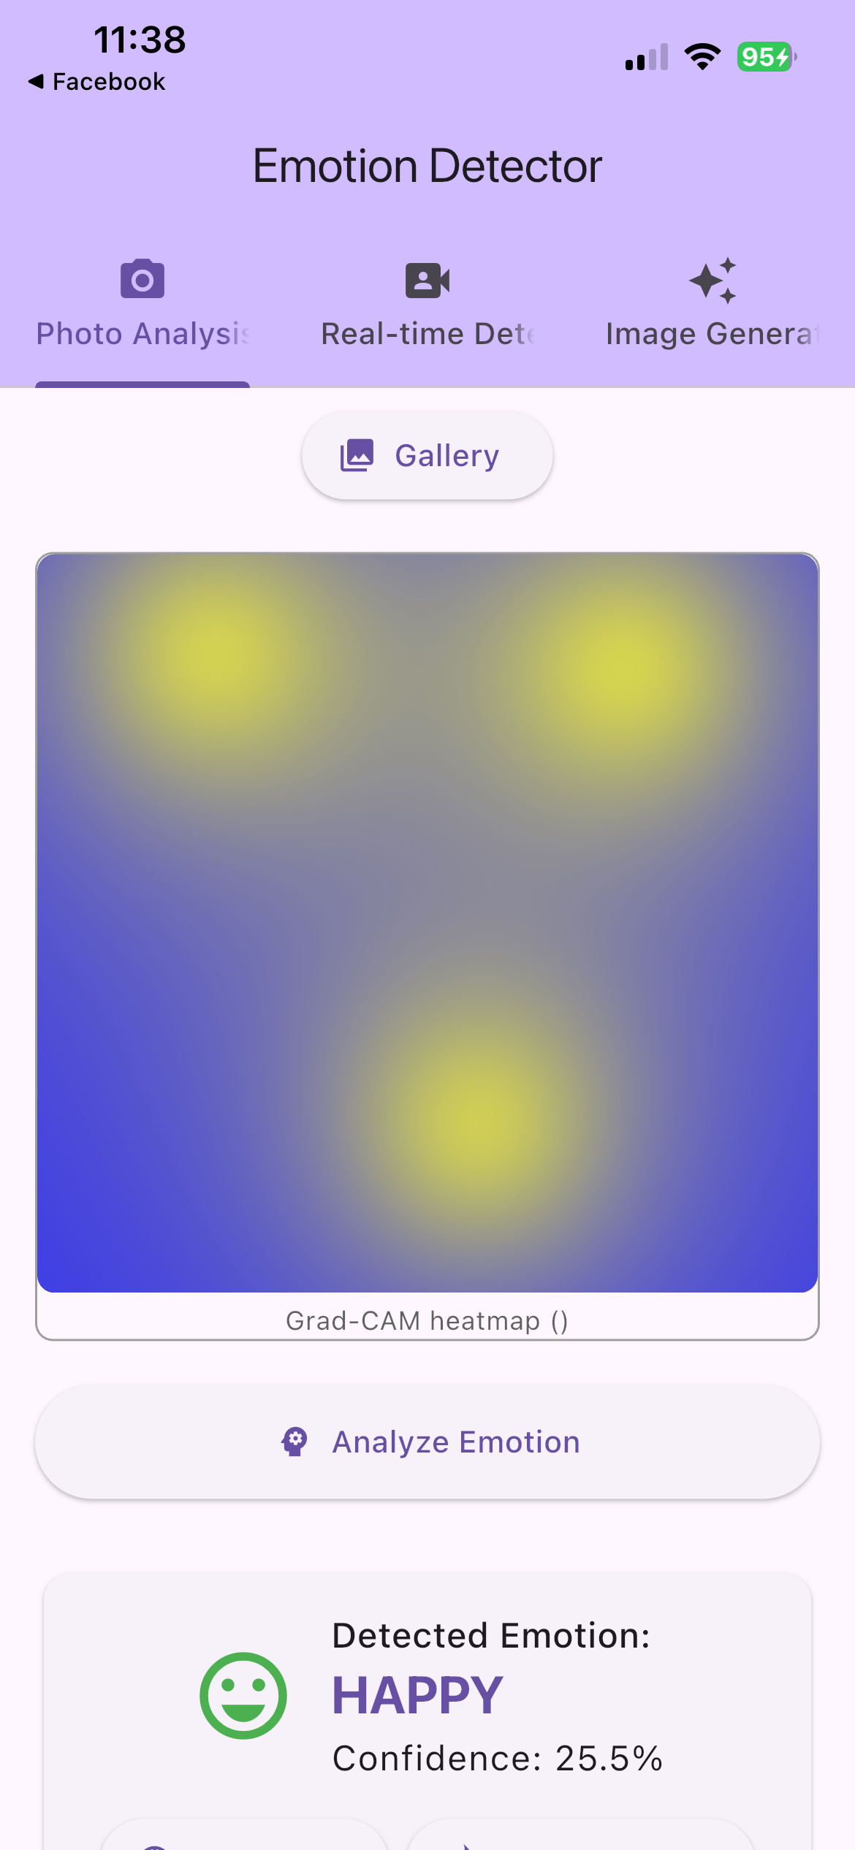
Explainability & XAI
Grad‑CAM: spatial saliency on final conv block
Grad‑CAM++: refined localisation for multiple regions
SHAP: additive feature attribution (global & local)
LIME: local surrogate models for misclassifications
[7] [8]

Slide 7
Results & Evaluation
Validation accuracy: 81.3%
Macro F1‑score: 0.813
Highest F1: happy (0.919); lowest: angry (0.796)
Balanced performance across classes
[9]

Slide 8
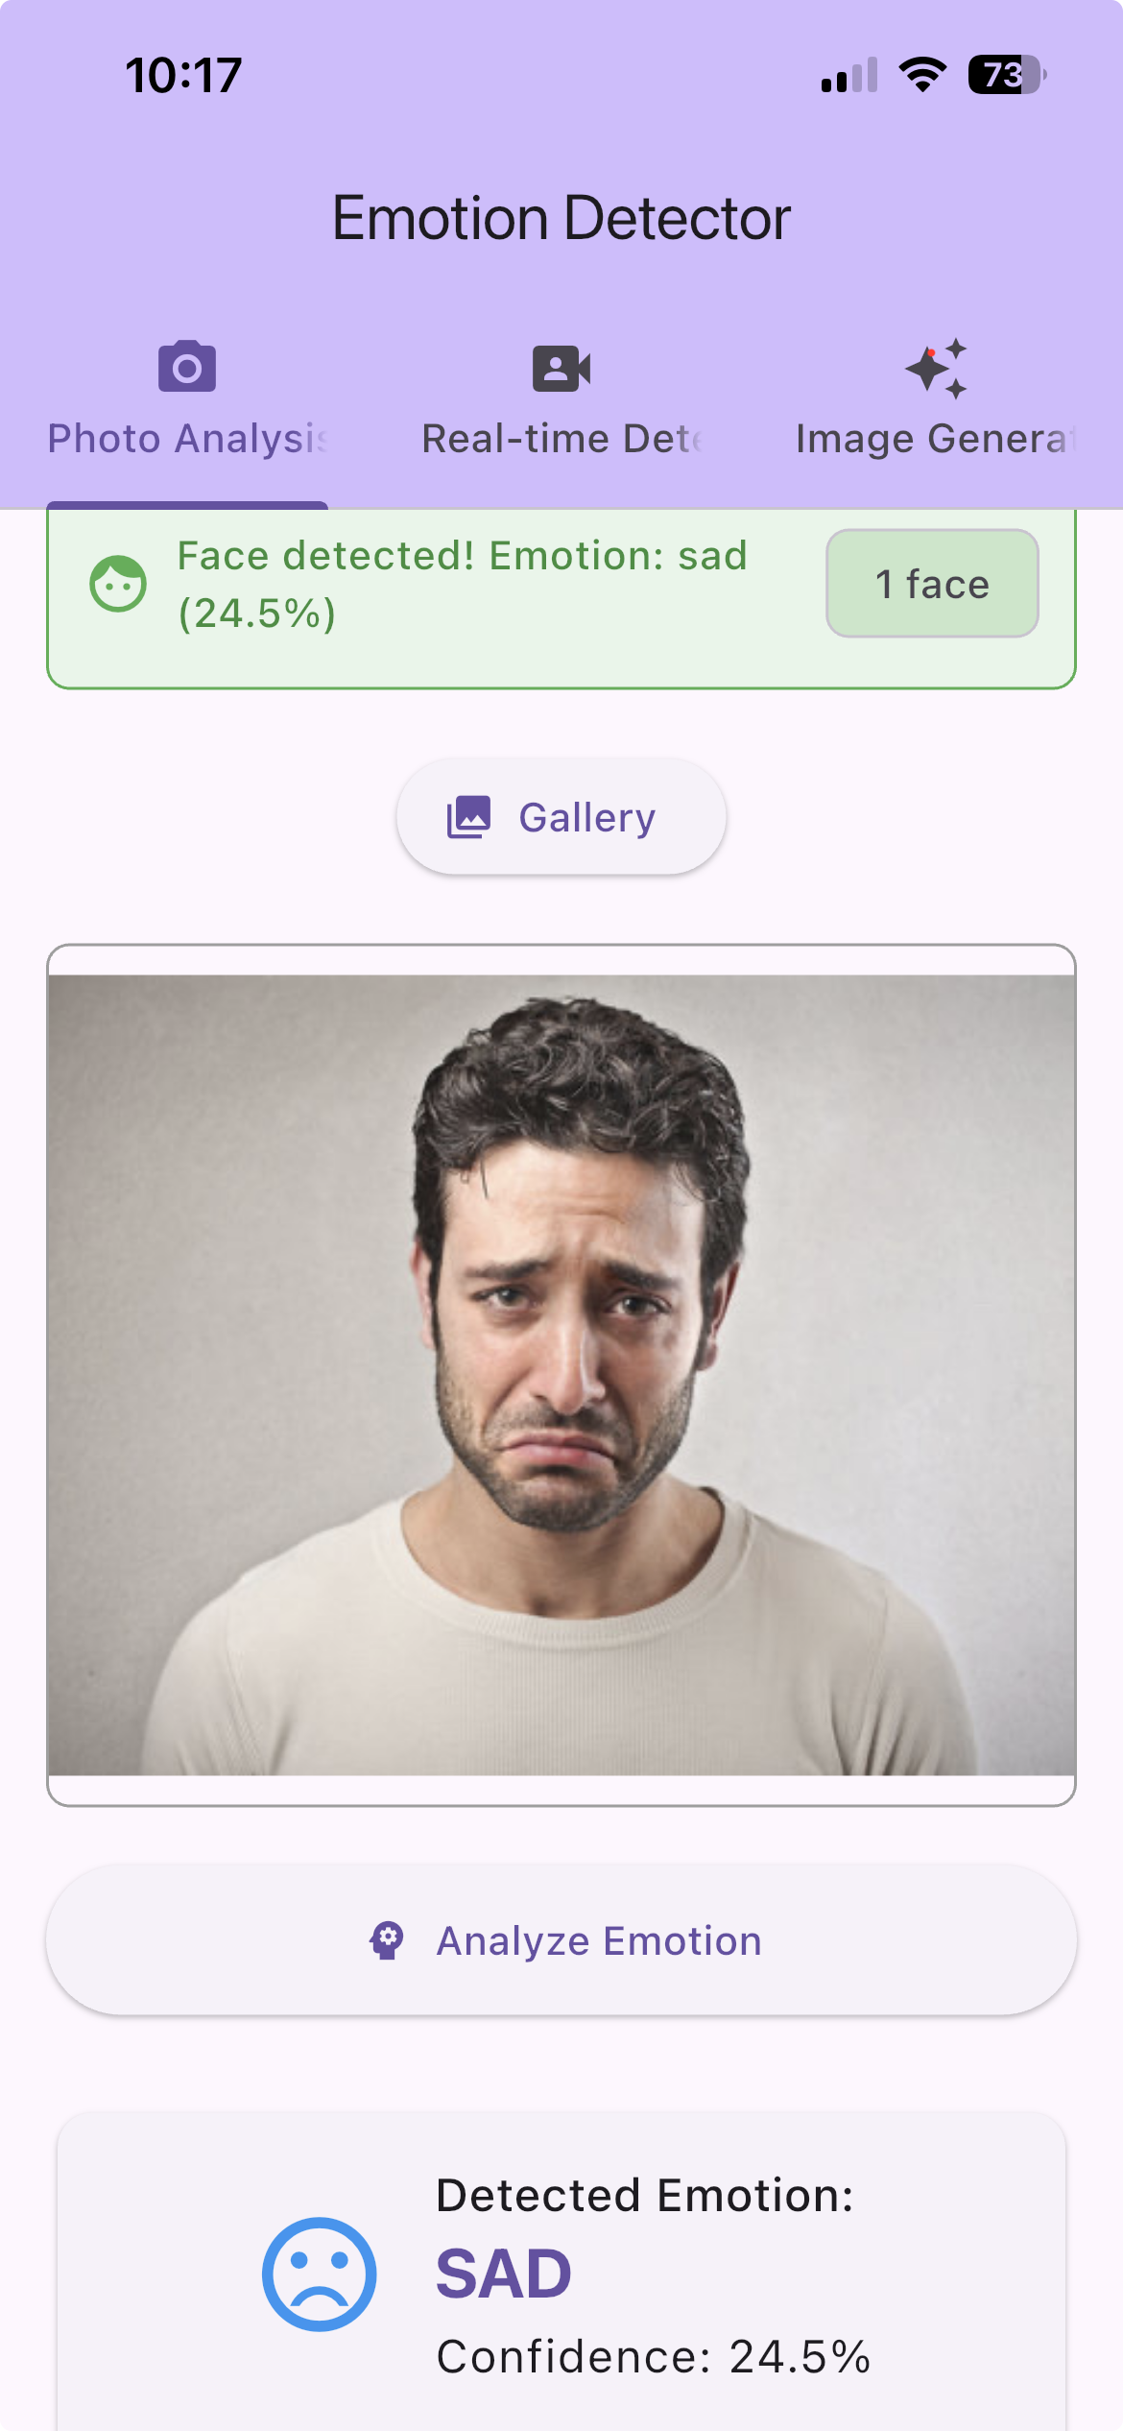
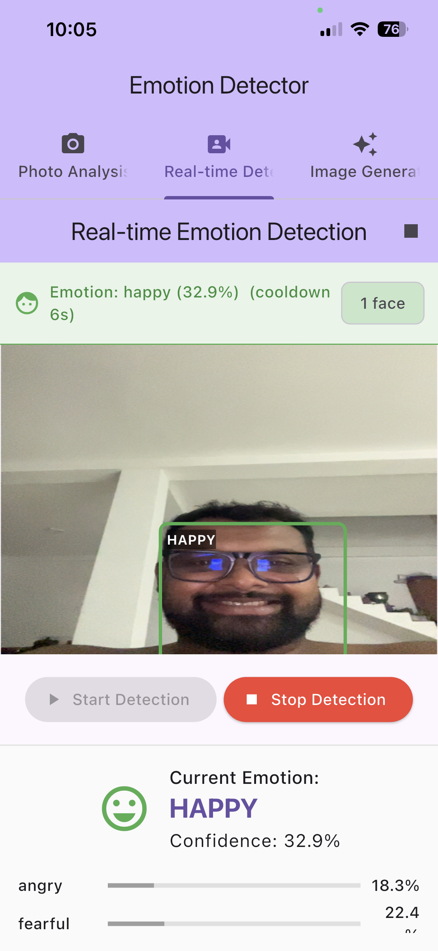
Mobile App Implementation
Device camera → ONNX inference on device
API fallback via HF_API_URL for remote inference
Real‑time detection with start/stop control
Gallery mode for analysing photos
Confidence bars and explanatory overlays
[10] [11]

Slide 9
LLMs & Transformer Theory
Self‑attention replaces recurrence to model global context
Multi‑head attention captures diverse relational patterns
Feed‑forward layers and residual connections stabilise training
Pretraining on massive corpora → fine‑tuning via prompts
[12]

Slide 10
GenAI vs Traditional Models
Aspect | Generative/LLM | Traditional NN
Data dependency | Pretrained on massive corpora; few‑shot generalisation | Requires task‑specific labelled data
Expressive power | Captures long‑range dependencies; multimodal generation | Specialised for vision or sequential data
Compute | High resource demands at training & inference | More efficient on edge devices
Interpretability | Attention weights & prompts; risk of hallucination | XAI techniques such as Grad‑CAM, SHAP, LIME
Safety | Outputs may contain biases; prompt‐sensitive | Deterministic but still inherits dataset biases
[13]

Slide 11
Conclusion & Future Work
Expanded dataset to 83 004 images; macro F1 ≈ 0.813
Progressive fine‑tuning and regularisation improved generalisation
GenAI pipeline boosted data diversity via diffusion models
Explainability via Grad‑CAM, SHAP & LIME enhances trust
Flutter app delivers real‑time emotion detection on device
Future: quantised ONNX for latency, fairness audits, multimodal LLMs
[14] [15]

